Slide 1
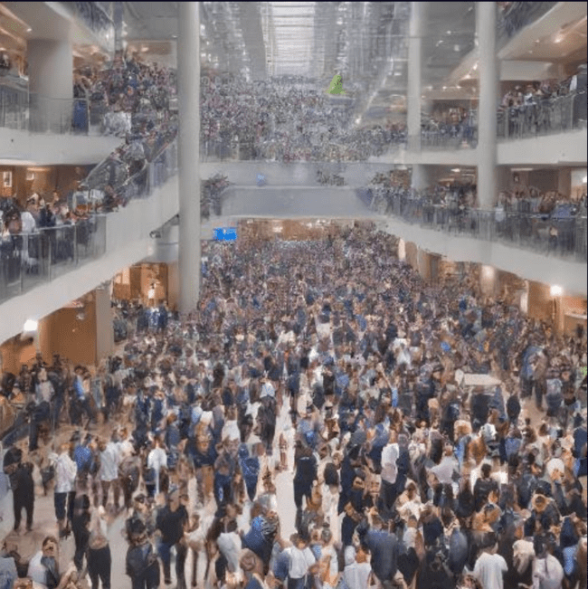
Internet of Things
CrowdSecure bracelet
Attendance and security monitoring at crowded places
Team Members:
Lina-Chemeliine Titova
Ana Angosto
Mikhail Pilipov

Slide 2
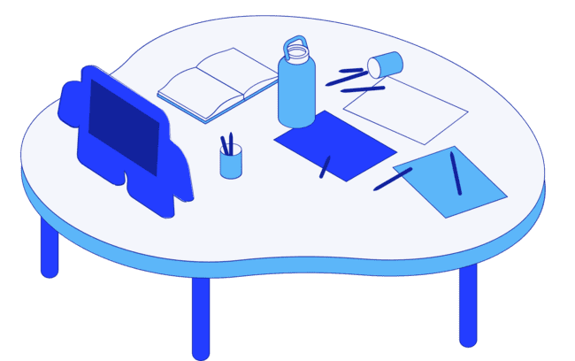
The main functions of the bracelet
General requirements from stakeholders
Key parameters that are monitored
Node-RED
Node-RED diagram of the project
Agenda
What to Know?

Slide 3
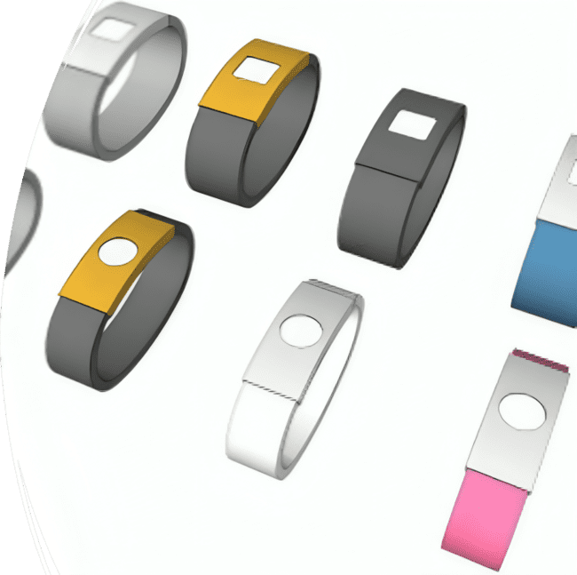
The main functions of the bracelet
Tracking GPS location
Event handling when the alarm button is pressed
Counting people in crowded places
Monitoring health parameters
Notes:
Machine learning frameworks are tools, libraries, and resources that provide a standardized way for developers and other professionals to tailor the machine learning algorithm’s functionality without comprising the underlying code.
The frameworks provide a simpler user interface that is accessible to many professionals instead of making it necessary to know and read code. Most of these are Python machine learning frameworks, primarily because Python is the most popular machine learning programming language.
During this seminar, I'm not gonna talk about only machine learning but also I’ll talk about the machine learning Frameworks.

Slide 4
General Requirements from stakeholders
Name | Description
Durability and comfort of bracelet | The bracelet has to be made from hypoallergenic, lightweight and durable materials
Adjustability | The bracelet should fit vatious wrist sizes
Wireless technologies | The bracelet should be equipped by Bluetooth, GPS, Wi-Fi
Necessary sensors | The bracelet should be equipped by Heartrate and Saturation sensors
Display | The bracelet’s screen should be bright and clear such as OLED or AMOLED with responsive touchscreen
Notes:
Machine learning frameworks are tools, libraries, and resources that provide a standardized way for developers and other professionals to tailor the machine learning algorithm’s functionality without comprising the underlying code.
The frameworks provide a simpler user interface that is accessible to many professionals instead of making it necessary to know and read code. Most of these are Python machine learning frameworks, primarily because Python is the most popular machine learning programming language.
During this seminar, I'm not gonna talk about only machine learning but also I’ll talk about the machine learning Frameworks.

Slide 5
General Requirements from stakeholders
Name | Description
Durability and water persistence | The bracelet is worn on the arm and therefore should be used in withstand various conditions
Crowd management | The bracelet has to provide real-time tracking of the people and emergency alerts
Intuitive interface | The bracelet should be intuitively understandable with multilingual support
Notes:
Machine learning frameworks are tools, libraries, and resources that provide a standardized way for developers and other professionals to tailor the machine learning algorithm’s functionality without comprising the underlying code.
The frameworks provide a simpler user interface that is accessible to many professionals instead of making it necessary to know and read code. Most of these are Python machine learning frameworks, primarily because Python is the most popular machine learning programming language.
During this seminar, I'm not gonna talk about only machine learning but also I’ll talk about the machine learning Frameworks.

Slide 6

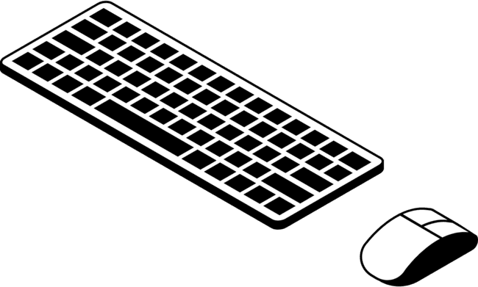
The key parameters to monitor
Heart Rate
Saturation - level of blood oxygen
GPS Location
Notes:
Machine learning frameworks are tools, libraries, and resources that provide a standardized way for developers and other professionals to tailor the machine learning algorithm’s functionality without comprising the underlying code.
The frameworks provide a simpler user interface that is accessible to many professionals instead of making it necessary to know and read code. Most of these are Python machine learning frameworks, primarily because Python is the most popular machine learning programming language.
During this seminar, I'm not gonna talk about only machine learning but also I’ll talk about the machine learning Frameworks.

Slide 7
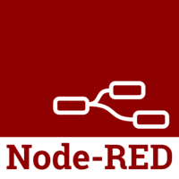
What is Node-RED?
Node-RED is a flow-based development tool for visual programming, designed for wiring together hardware devices, APIs, and online services as part of the IoT.
It provides a browser-based editor that makes it easy to wire together flows using the wide range of nodes in the palette, which can be deployed to its runtime in a single-click.

Slide 8
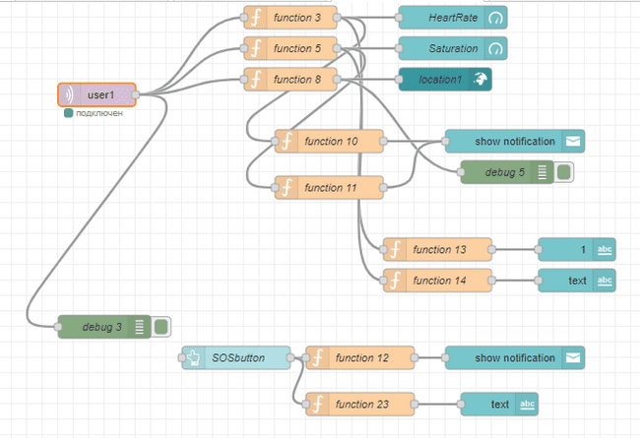
Bracelet scheme in Node-RED
MQTT Node Server: mqttserver@broker.emqx.io
MQTT Node topics:
user1, user2

Slide 9
How it works
The bracelet receives Heart Rate, Saturation and Location data from the MQTT broker, the data is visible on the screen using the dashboard nodes: Heart Rate and Saturation in Gaude and Location on the online map.
Also the presence of an SOS button, which sends a notification and is visible on the report.
When the Heart Rate and Saturation indicators are in dangerous situations (Heart Rate>150, Heart Rate<40 and Saturation <94) - a notification is sent and displayed in the report

Slide 10
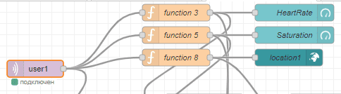
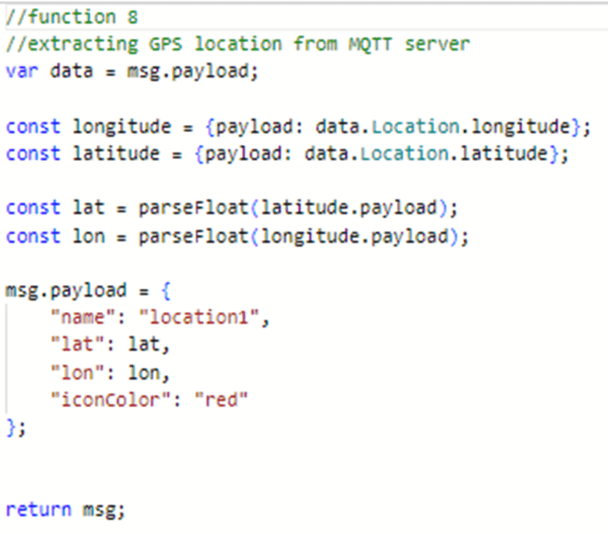
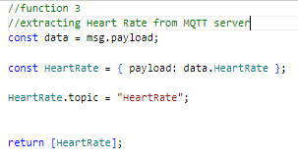
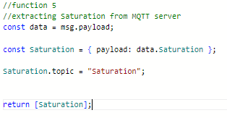
Bracelet scheme: extracting data from MQTT
Dashboard Nodes:
The guide: Heart Rate
The guide: Saturation
The worldmap: location 1,2
In the functions, data from the mqtt broker was assigned to the dashboard nodes

Slide 11
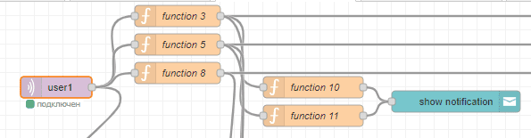
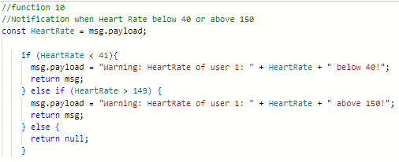
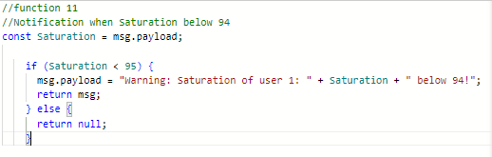
Bracelet scheme: notification
Dashboard Node:
The notification
The functions monitor Heart Rate and Saturation data extracted from the MQTT broker

Slide 12
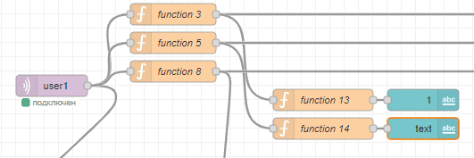
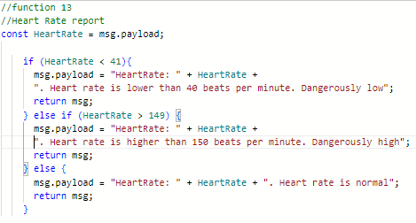
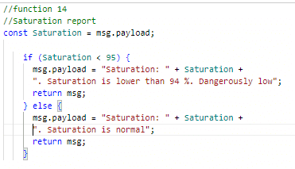
Bracelet scheme: report
Dashboard Node:
The text
The functions show Heart Rate and Saturation reports

Slide 13
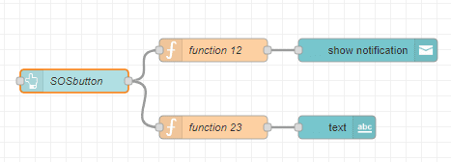
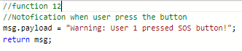
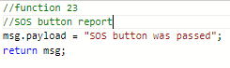
Bracelet scheme: SOS button
Dashboard Node:
The notification
The text
The functions trigger notification and show on report if SOS button was pressed

Slide 14
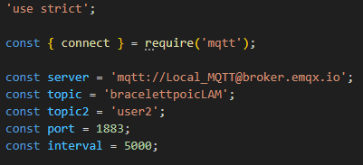
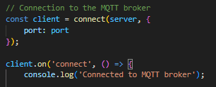
Generating data in a MQTT broker
Connection to the MQTT broker (JavaScript code)

Slide 15
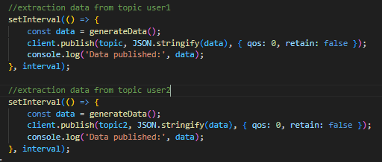
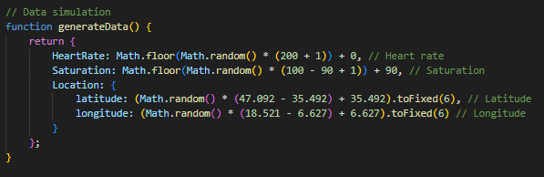
Generating data in a MQTT broker
Generating Heart Rate, Saturation and Location in topics in a MQTT broker

Slide 16
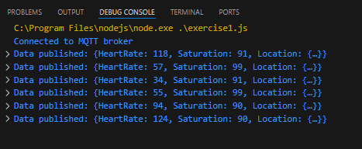
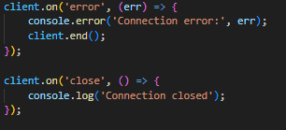
Generating data in a MQTT broker
The end of the code
Generated data

Slide 17
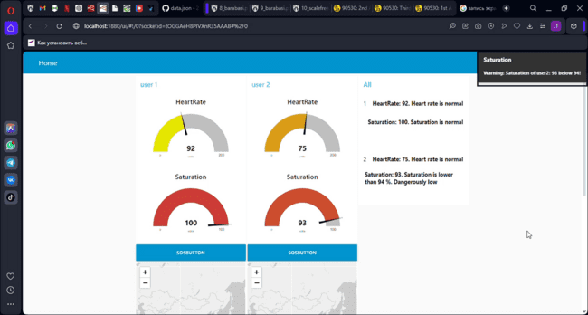
Node-RED dashboard

Slide 18
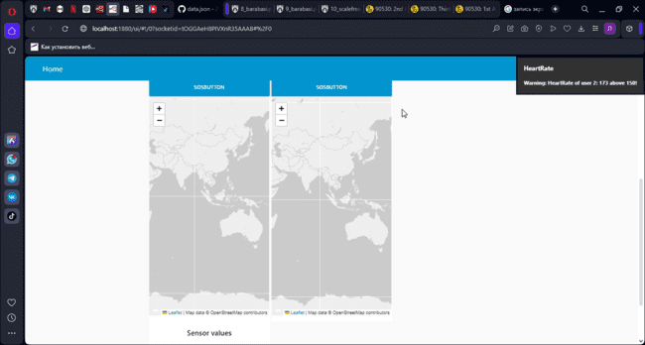
Node-RED dashboard

Slide 19

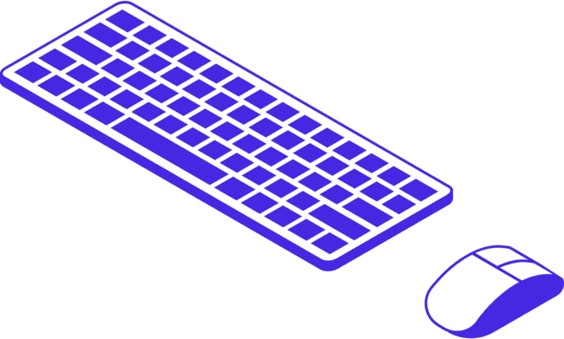
Thank you for your attention!

Slide 20
References
Node-RED, flow-based programming for Internet of Things
Html.it| Article | Paolo Patierno | 2023
Learn: MQTT broker
Catchpoint.com| Web-site material | Catchpoint | 2021
What is MQTT and why it is important for the Internet of Things
Akenza.io | Article | Alexis Leibbrandt | 2023
MQTT Protocol Guide: Everything You Need to Know
Cedalo.com | Article | Tizian Prokosch| 2023
Tutorial: Connecting Devices to the IoT Platform with Node-RED & MQTT
Kaaiot.com | Web-site material | KaaIoT | 2023
Tutorial: Node-RED tutorial: How to get GPS coordinates with a Maps Widget
Industrialshields.com | Article | Fernandez Queralt Martinez | 2021

Slide 21
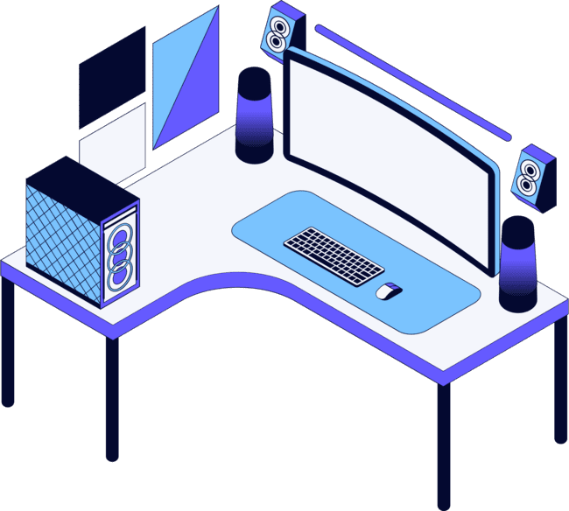






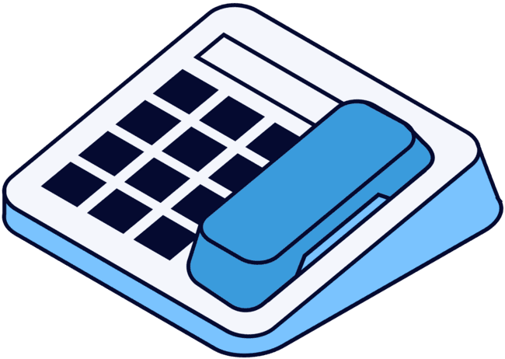
Q&A

